Slide 1


R Refresher Exercise
Random Walk

Slide 2
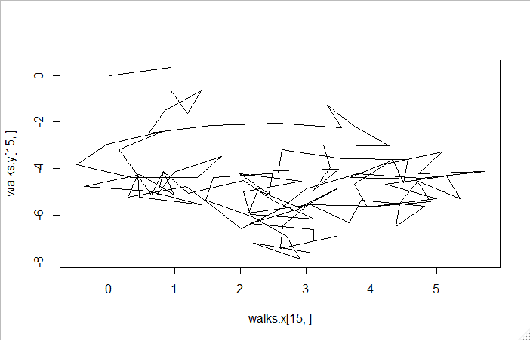
Exercise
Random walk
Goals:
Create the data for a random walk of length n steps starting at the origin
Each step travels a length of 1 in a random direction
Plot the random walk
Repeat 30 times to get data about how far the walk has traveled from the origin
Vary the number of steps n from 10 to 100 by 10 to see the relationship between n and the resulting average distance from the origin
Hypothesize about how far away you think it will be and plot the average distance vs step size against your expected distance

Slide 3
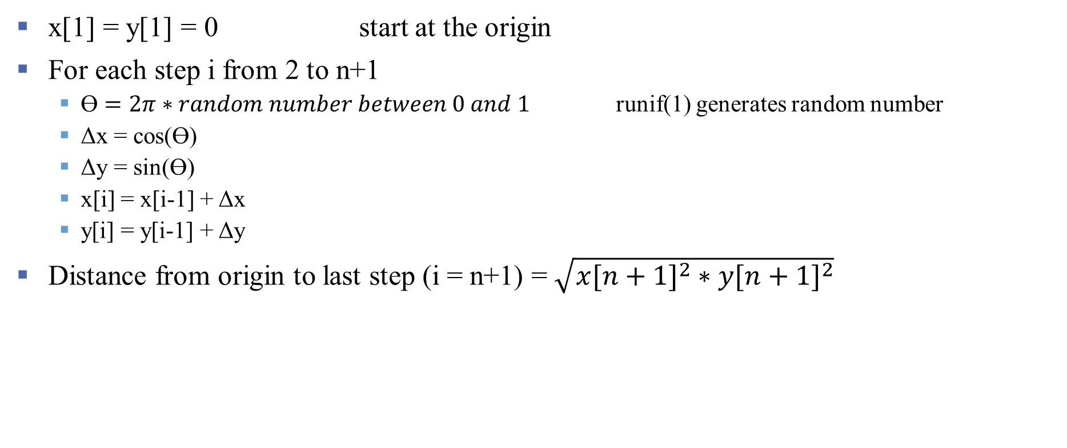
Random Walk Algorithm
x[1] = y[1] = 0 start at the origin
For each step i from 2 to n+1
ϴ $=2π∗random number between 0 and 1$ runif(1) generates random number
Δx = cos(ϴ)
Δy = sin(ϴ)
x[i] = x[i-1] + Δx
y[i] = y[i-1] + Δy
Distance from origin to last step (i = n+1) = $\sqrt{{x[n+1]}^{2}∗{y[n+1]}^{2}}$

